Slide 1

NATIONAL UNIVERSITY OF MODERN LANGUAGES
Faculty of Engineering and Computing
Department of Software Engineering

Slide 2

SOFTWARE DESIGN AND ARCHITECTURE
LECTURE NO. 7
Introduction to Software Engineering Design
Course Instructor: | Mr. Ahsan Arif
 | Lecturer Department of Software Engineering NUML Islamabad
Date: March 25, 2024
Software Engineering Design: Theory and Practice

Slide 3
LECTURE CONTENTS
  Introduction to Activity Diagram (Process View)
    What is activity diagram?
    Elements/Notations of activity diagram
    Activity Diagram Generation (Step-by-step with examples)
Date: March 25, 2024
Software Engineering Design: Theory and Practice

Slide 4

UML – ACTIVITY DIAGRAM
What is ACTIVITY diagram?
The activity diagram is a flowchart to represent the flow of control among the activities in a system.
The flow of operation can be sequential, branched or concurrent. The activity diagram is sometimes considered as the flowchart. Although the diagrams look like a flowchart, they are not.
Use Case
Communication
Sequence
Class Diagram
Date: March 25, 2024
Software Engineering Design: Theory and Practice
Notes:
Class diagrams model the static behavior of objects, i.e.
Attributes of objects
Operation of objects
Relationships between objects.

Slide 5
Start Node
  The black small filled circle is the standard notation for an initial state before an activity takes place.
  Final Activity Node
  The black circle that looks like a selected radio button is the symbol for the end state of activity.
Notations of activity diagram:
Start
Start Node
Start in Flow Chart
End
Final Activity Node
End in Flow Chart
Date: March 25, 2024
Software Engineering Design: Theory and Practice
Notes:
Class diagrams model the static behavior of objects, i.e.
Attributes of objects
Operation of objects
Relationships between objects.

Slide 6
Notations of activity diagram:
Activity
  The activity symbols are the basic building blocks of an activity diagram and usually have a short description of the activity they represent.
  Control Flow
  A solid line with an arrow represent the direction flow of the activities. The arrow points in the direction of progressing activities.
Activity
Activity
Control Flow
Date: March 25, 2024
Software Engineering Design: Theory and Practice
Notes:
Class diagrams model the static behavior of objects, i.e.
Attributes of objects
Operation of objects
Relationships between objects.

Slide 7
Notations of activity diagram:
Join and Fork Node
  A join combines two concurrent activities back into a flow where only one activity is happening at a time.
  A fork splits single activity flow into two concurrent activities.
Join Node
Fork Node
Date: March 25, 2024
Software Engineering Design: Theory and Practice
Notes:
Class diagrams model the static behavior of objects, i.e.
Attributes of objects
Operation of objects
Relationships between objects.

Slide 8
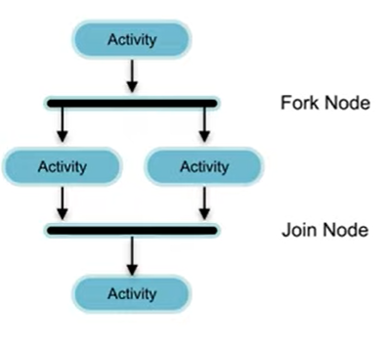
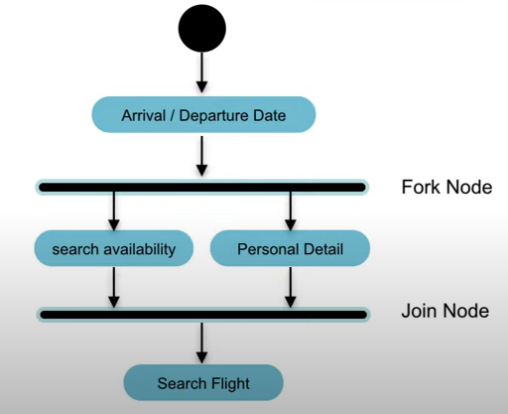
Join and Fork Node – Example
Online Flight Reservation System
Date: March 25, 2024
Software Engineering Design: Theory and Practice
Notes:
Class diagrams model the static behavior of objects, i.e.
Attributes of objects
Operation of objects
Relationships between objects.

Slide 9
Notations of activity diagram:
Decision Symbol
  It is similar to the flow chart which is represented by the diamond shape:
  where two paths coming out of a decision and the condition text lets you know which options are mutually exclusive.
Condition
  Condition text is placed next to a decision marker to let you know:
  under what condition an activity flow should split off in that direction.
[Condition]
[Condition]
[False]
Date: March 25, 2024
Software Engineering Design: Theory and Practice
Notes:
Mutually exclusive refers to situations where two or more events cannot happen at the same time.

Slide 10
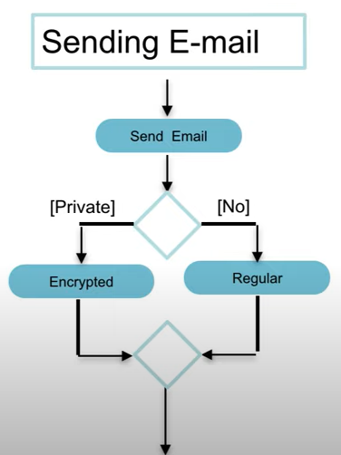
Notations of activity diagram:
Merge Node
  Merge is similar to the join where two activities are merged with the condition and only one activity flows forward.
  For example: While Sending E-mail, if the email is private, encrypted it before sending it while if not private, send as regular mail. These two activities are merged with the merge node which is the same as the decision represented by a diamond shape.
  In Decision one activity as input and there will be two output according to a condition whereas in;
  Merge two activities are input and output only one activity.
Merge Node
Date: March 25, 2024
Software Engineering Design: Theory and Practice
Notes:
Class diagrams model the static behavior of objects, i.e.
Attributes of objects
Operation of objects
Relationships between objects.

Slide 11
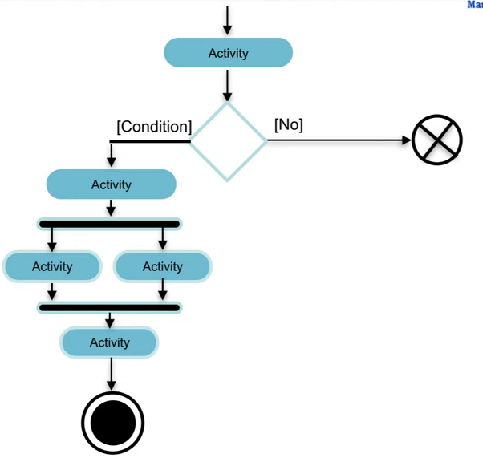
Notations of activity diagram:
Final Flow Node
  It may be confusing with the final activity node. It represents the end of a specific process flow which is denoted by a circle with cross lines inside the circle.
Final Flow Node
Date: March 25, 2024
Software Engineering Design: Theory and Practice
Notes:
Class diagrams model the static behavior of objects, i.e.
Attributes of objects
Operation of objects
Relationships between objects.

Slide 12
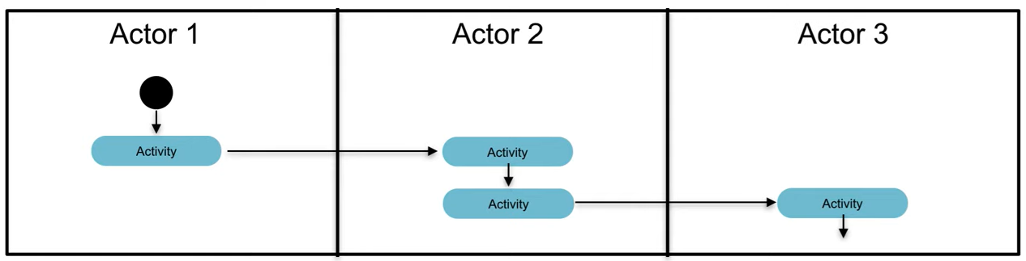
Notations of activity diagram:
Partition
  Activity diagram partition is also known as swim lanes which are used to represent or group actions carried out by different actors in a single thread (sequential flow of actions).
Date: March 25, 2024
Software Engineering Design: Theory and Practice
Notes:
In the context of activity diagrams and swim lanes, a "single thread" refers to a sequential flow of actions. It means all the activities within a single swim lane (or partition) happen one after another, without any branching or parallel execution.

Slide 13
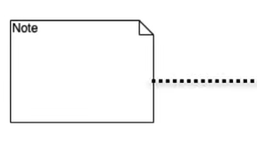
Notations of activity diagram:
Note or Comment:
  This is similar to the sequence diagram, used to add relevant comments to elements that are represented by one corner folded symbol.
Date: March 25, 2024
Software Engineering Design: Theory and Practice
Notes:
Class diagrams model the static behavior of objects, i.e.
Attributes of objects
Operation of objects
Relationships between objects.

Slide 14
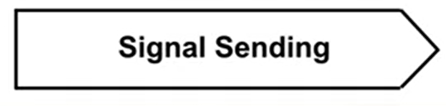
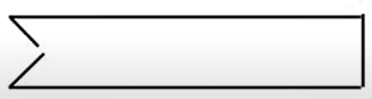
Notations of activity diagram:
Signal Sending:
  Signal Sending which is used to represent the action of sending a signal to an accepting activity.
Signal Receipt:
  Signal receipt, which is used to represent that signal is received.
Date: March 25, 2024
Software Engineering Design: Theory and Practice
Notes:
Class diagrams model the static behavior of objects, i.e.
Attributes of objects
Operation of objects
Relationships between objects.

Slide 15
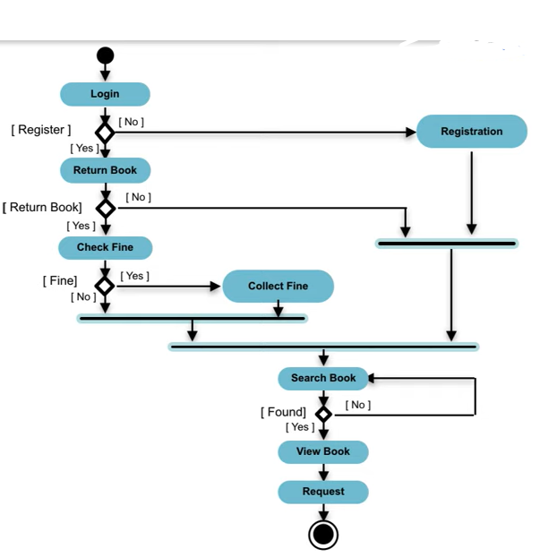
Example – Diagram
Date: March 25, 2024
Software Engineering Design: Theory and Practice

Slide 16
Example – Diagram
Alice arrives at an ATM, ready to withdraw some cash. She inserts her card and enters her PIN. The ATM verifies the PIN with the bank. If valid, Alice selects “Withdraw Cash” and enters the desired amount. The ATM confirms the amount for her approval. Meanwhile, the ATM checks with the bank to ensure sufficient funds exist in Alice’s account. With everything approved, the ATM dispenses the cash. Alice retrieves her card as it ejects from the machine, grabs the dispensed bills (if not done simultaneously), and finishes her ATM transaction.
Date: March 25, 2024
Software Engineering Design: Theory and Practice

Slide 17

Date: March 25, 2024
Software Engineering Design: Theory and Practice

Slide 18
References
https://creately.com/guides/class-diagram-relationships/#reflexive-association
https://www.slideshare.net/Nadia_Nazeer/class-diagrams-64840010
https://slideplayer.com/slide/8318914/
https://modeltron.com/home/activity-final-vs-flow-final-nodes
https://www.uml-diagrams.org/activity-diagrams-controls.html
Date: March 25, 2024
Software Engineering Design: Theory and Practice

Slide 19
Thank You...
Mr. Ahsan Arif
Lecturer (Dept. of Software Engineering)
ahsanarif.se42@gmail.com
Date: March 25, 2024
Software Engineering Design: Theory and Practice

